Slide 1
Enterprise systems development Robert Barclay – 17043733
Micah Hobby – 17027531 Agile Associates Anonymous Rodrigo Sanchez – 17044007 George Greenfield – 17025822 James Jeremiah – 17042447
System architecture for AAA web application:
Page 1
Delete
Login
Sub controller
Controller
Login function
New User
Model entity
Entity specific DAO
Dynamic data access object
View prescription
Database Process
Request
Response
Patient dashboard
Sub controller
Make Payments
Model entity
Response
Browser
Book appointment
Model entity
Response
View appointments
Staff dashboard
Sub controller
Offer prescription

Slide 2
Enterprise systems development Robert Barclay – 17043733
Micah Hobby – 17027531 Agile Associates Anonymous Rodrigo Sanchez – 17044007 George Greenfield – 17025822 James Jeremiah – 17042447
System architecture for AAA web application:
Page 2
Approve user
Admin dashboard
Sub controller
Controller
CRUD users / organisations / Appointments
Model entity
Manage accounts
Entity specific DAO
Database Process
Request
Dynamic data access object
Response
Browser
Calculate turnover
Response
Records service
Sub controller
Model entity
Generate surgery invoice

Slide 3
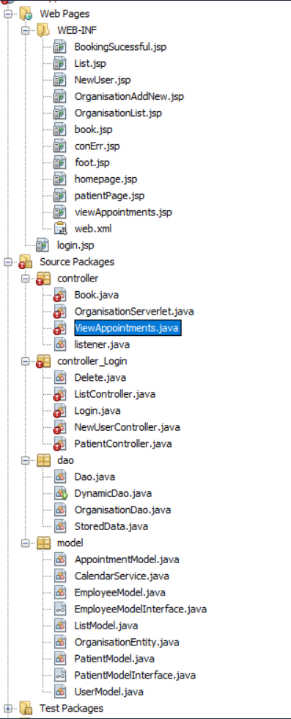
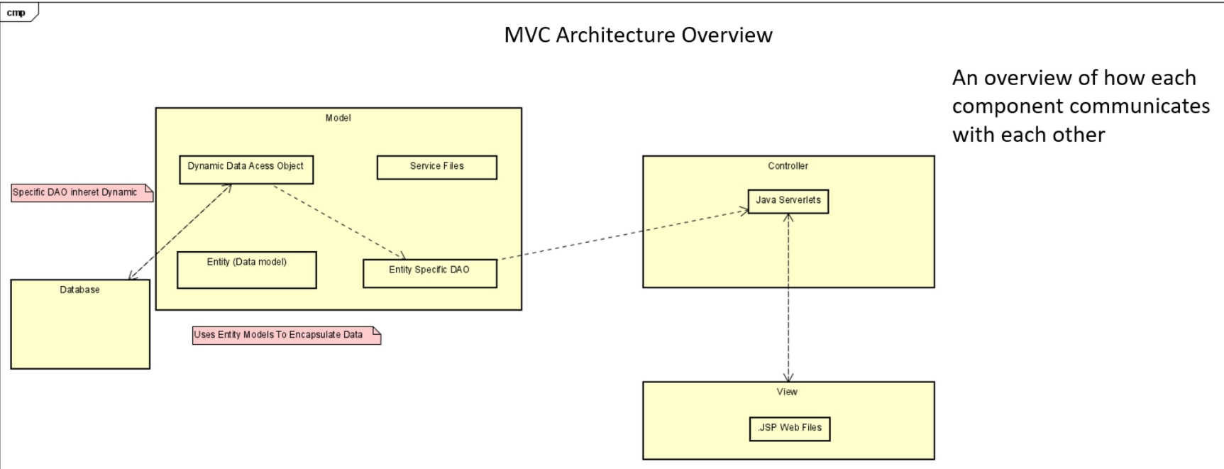
Files
Basis

Slide 4
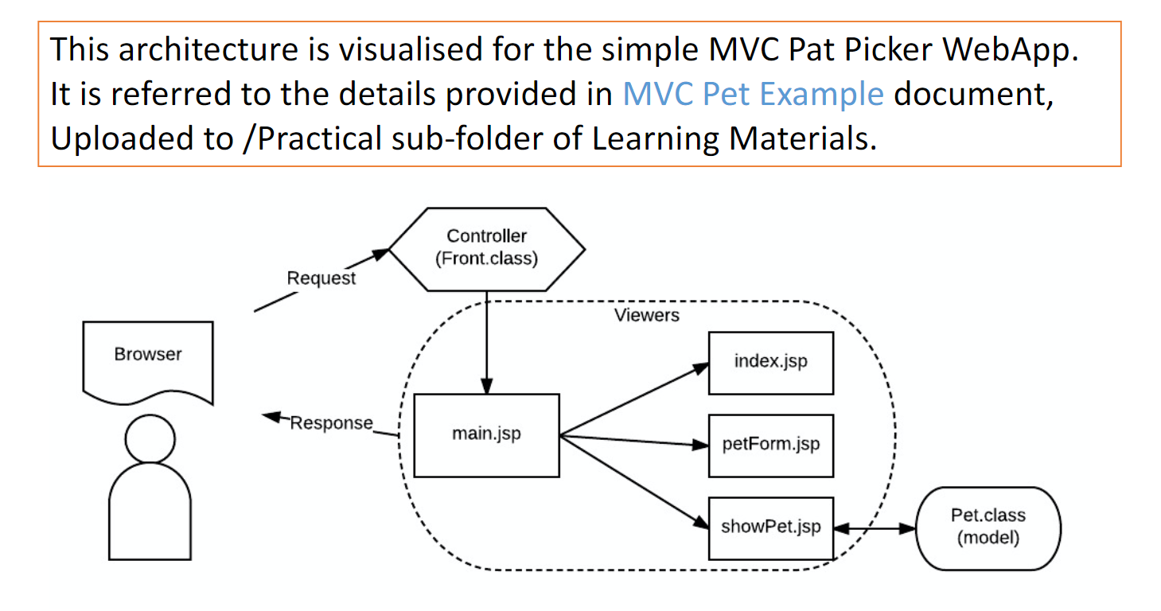
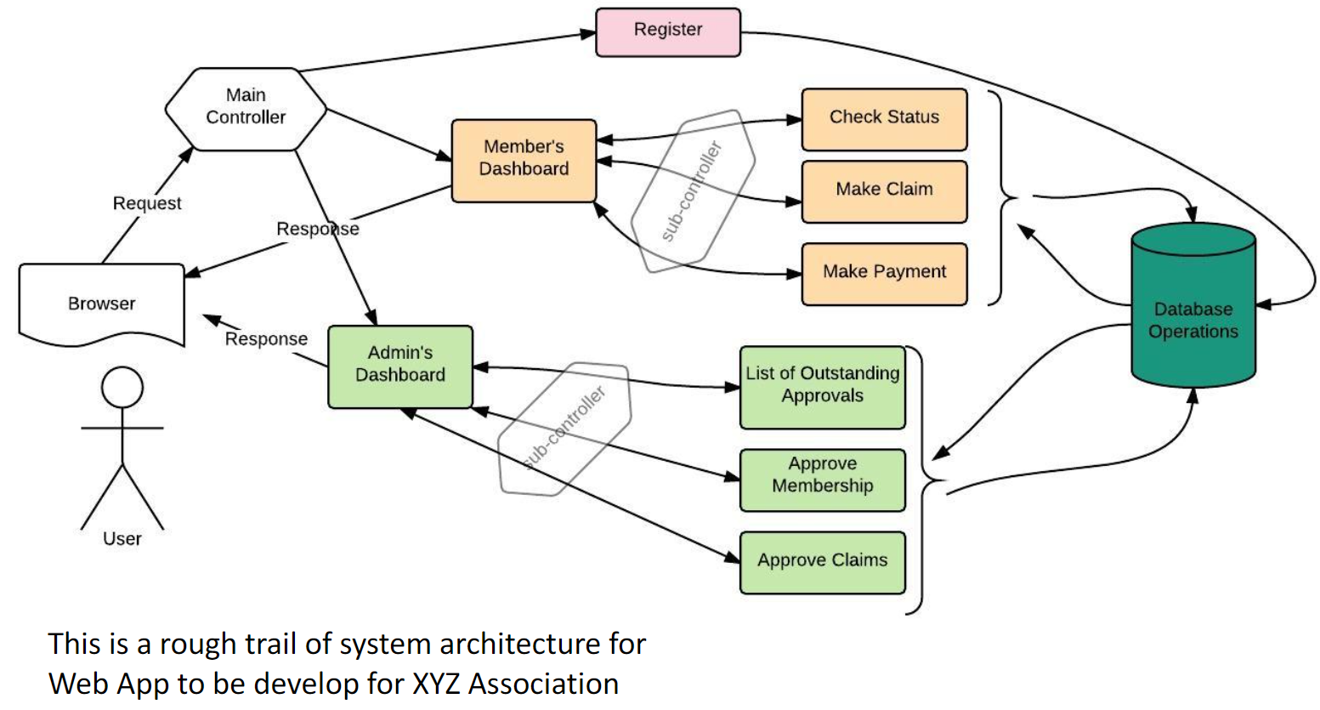
Mehmet example

Slide 5
Enterprise systems development Robert Barclay – 17043733
Micah Hobby – 17027531 Agile Associates Anonymous Rodrigo Sanchez – 17044007 George Greenfield – 17025822 James Jeremiah – 17042447
System architecture for AAA web application:
Delete
Controller
Login function
Sub controller
Login
New User
Entity specific DAO
Dynamic data access object
Database Process
Request
Response
Browser
Response
View appointments
Booking function
Sub controller
Book

Slide 6
Enterprise systems development Robert Barclay – 17043733
Micah Hobby – 17027531 Agile Associates Anonymous Rodrigo Sanchez – 17044007 George Greenfield – 17025822 James Jeremiah – 17042447
File
Response
Request
System architecture for AAA web application:
Delete
Model entity
Controller
Login function
Sub controller
Login
New User
Entity specific DAO
Dynamic data access object
Database Process
Report service
Request
Response
Browser
View appointments
Response
Book
Sub controller
Booking function
Organisational servlet

Slide 7
Enterprise systems development Robert Barclay – 17043733
Micah Hobby – 17027531 Agile Associates Anonymous Rodrigo Sanchez – 17044007 George Greenfield – 17025822 James Jeremiah – 17042447
File
Response
Request
System architecture for AAA web application:
Page 1
Model entity
Controller
Delete
Login function
Sub controller
Login
Entity specific DAO
Dynamic data access object
Database Process
New User
Request
Response
Browser
View appointments
Response
Book
Sub controller
Organisational servlet
Booking function

Slide 8
Enterprise systems development Robert Barclay – 17043733
Micah Hobby – 17027531 Agile Associates Anonymous Rodrigo Sanchez – 17044007 George Greenfield – 17025822 James Jeremiah – 17042447
File
Response
Request
System architecture for AAA web application:
Page 2
Report service
Model entity
Controller
Entity specific DAO
Dynamic data access object
Database Process
Request
Response
Browser
Response
Admin panel
Sub controller

